Slide 1

(ANN) Approximate Nearest
Neighbour Algorithm Analysis
(Machine Learning)
Debantam Majilla
BDA,Ist Year

Slide 2
Types Of Nearest Neighbour Searches
K-d Tree
Ball-Tree
Brute Force Search
Systematically enumerates all possible Points for the solution and checks whether each candidate satisfies the problem's statement.
It is a space partitioning data structure for organizing points in a K-Dimensional space
It is Also a space partitioning data structure

Slide 3
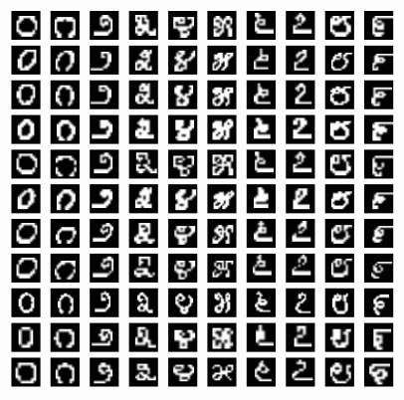
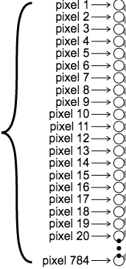
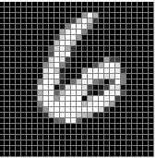
Data Sets Used:
Fruits Dataset
Diabetes Dataset
MNIST Dataset
MNIST : 60,000 hand written digit pictures, Each of pixel dimension 28x28
Every image has 28*28=784 pixel value associated with it.
28× 28
Input Data: 60000 × 784 Dimensional (High)
784× 1

Slide 4
Fast computation of nearest neighbours is an active area of research in machine learning
Brute Force Search
Time Complexity : Very High O(DN²)
It is An Exhaustive search Technique
Generally Used IN KNN model
Test Point assigns to Class C1, K=3
C2
C3
C1

Slide 5
Curse Of Dimensionality
KNN (K Nearest Neighbours) is slow when you have a lot of observations, since it does not generalize over data in advance, it scans historical database each time a prediction is needed.
The Effects of Dimensionality , in high dimensional spaces distances between nearest and farthest points from query points become almost equal. Therefore, nearest neighbour calculations cannot discriminate candidate points.
There are various algorithms for searching Nearest Neighbours like Ball-Tree , K-D Tree, Brute Force Method .

Slide 6
Making Nearest Search Faster
Training: O(1) , Testing : O(nd)
Either Reduce d : Dimensionality Reduction Techniques
- Simple Feature Selection , Factor Analysis
- It is Itself O(n³ )
- Not promising unless it is low Dimension.
Reduce n : Don’t Compare All Training Examples
- Choose Approximately M<< N examples
By Cutting the space.
- O(md) which is < O(nd)
Here Comes K-d Tree, Ball-Tree, Inverted Lists, Hashing

Slide 7
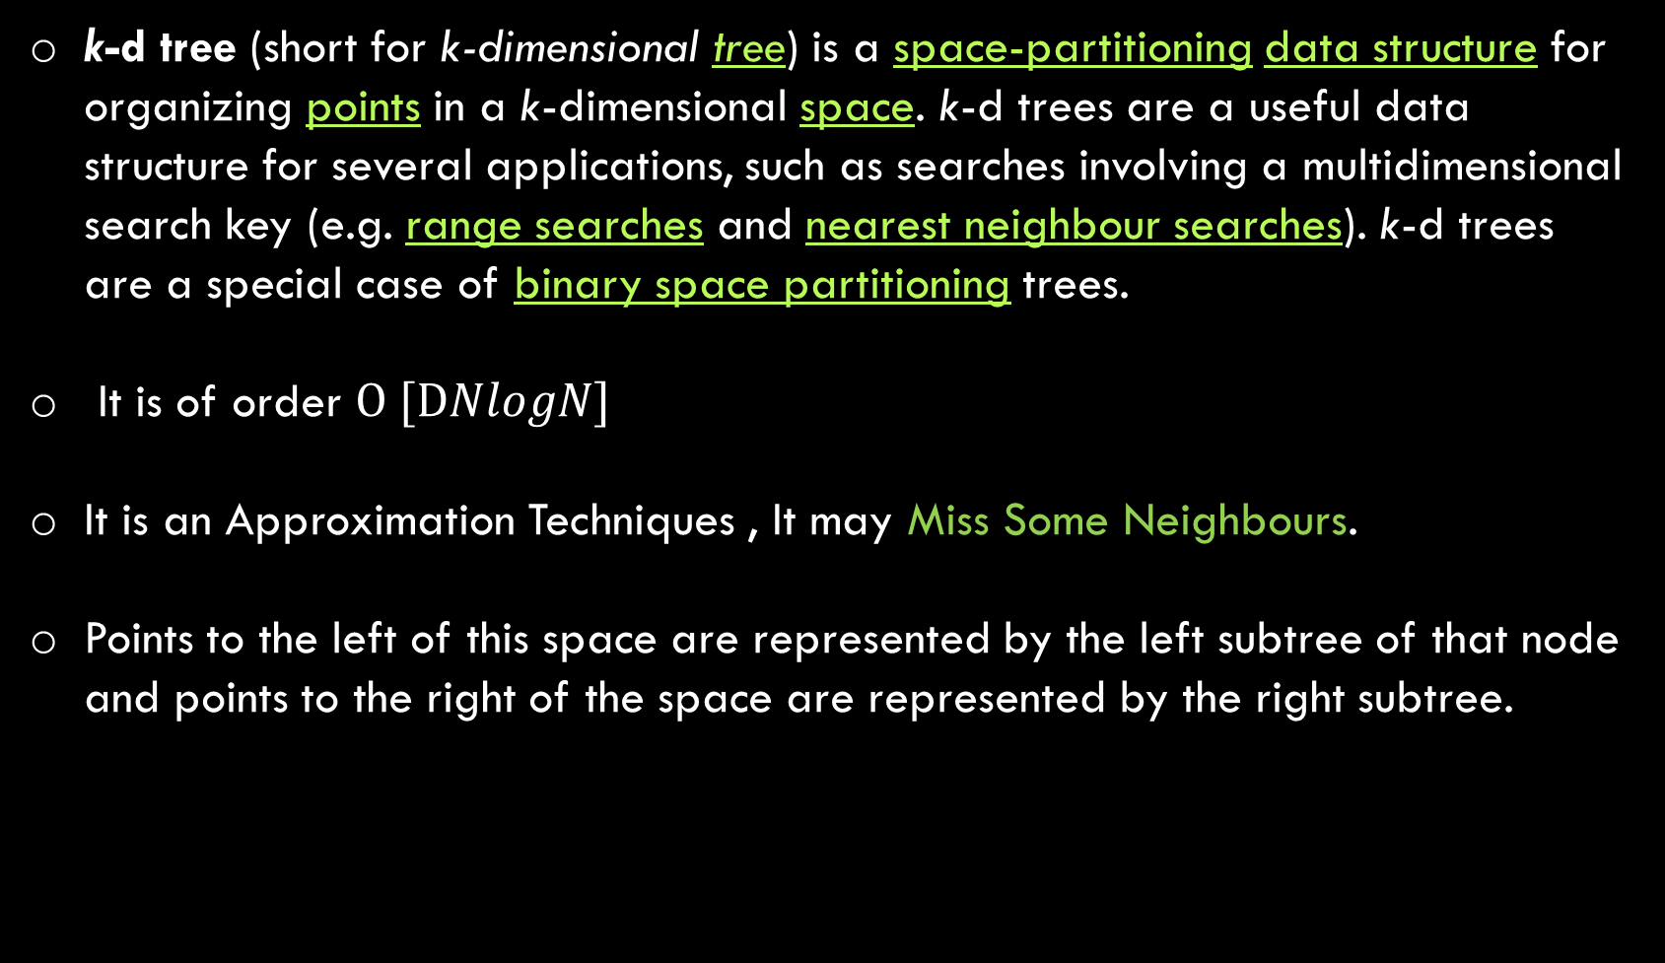
K-d TREE
k-d tree (short for k-dimensional tree) is a space-partitioning data structure for organizing points in a k-dimensional space. k-d trees are a useful data structure for several applications, such as searches involving a multidimensional search key (e.g. range searches and nearest neighbour searches). k-d trees are a special case of binary space partitioning trees.
It is of order $O [DNlogN]$
It is an Approximation Techniques , It may Miss Some Neighbours.
Points to the left of this space are represented by the left subtree of that node and points to the right of the space are represented by the right subtree.

Slide 8
We take the Data and split the data points into two half's in the dimension of
highest Variance.
Then we take those split Data points and again divide into half's , in the direction
of present splits Highest Variance.
We continue to split until our data points left.
We build the Sub-Trees Like this.
12
22
0
11
21
1
2
11
1
2
12
21
22

Slide 9
0
12
22
1
2
11
12
21
22
This is for 2-D Nearest Neighbour search.
Advantage:
No explicit Distance Calculations.
11
21
1
2
What For N-Dimensional Search ?

Slide 10
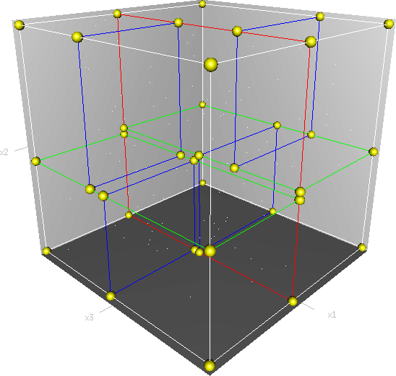
N-Dimensional Space
Infinite No of Splits.
Each Data Point will be situated at
Every Box’s Corner
K-d Tree’s DOES NOT work Well in High
Dimensions. Time Complexity will be
Much High.

Slide 11
Ball TREE
Ball tree is also a space-partitioning data structure for organizing points in a Multi-dimensional space. The ball tree gets its name from the fact that it partitions data points into a nested set of hyperspheres known as "balls“
Works exactly like K-d Trees, Cuts spaces into Spheres in place of Regions
earlier.
Advantage: Completely invariant of the space Dimension.
Works much faster Than K-d Tree in High Dimensions.
The idea is to prune of large portions of the database so that they don’t need to be searched, but this requires that they keep extra information in memory.

Slide 12
Mean
Gives you highest variance
Ball TREE

Slide 13
Performance Evaluation: Ball-Tree and KD-Tree in the context of MST ~ Munaga, Jarugumalli (2012)
What is a Good Nearest Neighbours Algorithm for Finding Similar Patches in Images? ~ Kumar,Zhang,Nayar (2008)
Brute Force may be the most accurate method due to the consideration of all data points. Hence, no data point is assigned to a false cluster. For small data sets, Brute Force is justifiable, however, for increasing data the KD or Ball Tree is better alternatives due to their speed and efficiency.
For low-dimensional data, the KD Tree Algorithm might be the best solution. As seen above, the node divisions of the KD Tree are axis-aligned and cannot take a different shape. So the distribution might not be correctly mapped, leading to poor performance.
For a high-dimensional space, the Ball Tree Algorithm might be the best solution. Its performance depends on the amount of training data, the dimensionality, and the structure of the data. Having many data points that are noise can also lead to a bad performance due to no clear structure.

Slide 14
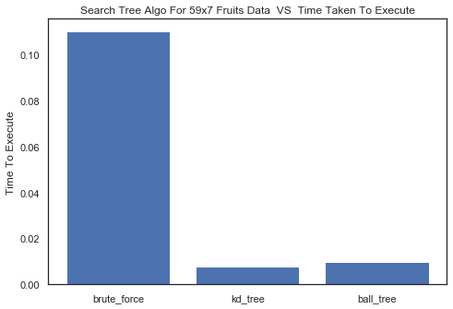
Project Work
LOW DIMENSION
Fruits Data : N=59
D=7
-Brute Force Search does not work Well
-Ball-Tree Works Better Than Brute Force Search
-K-d Tree also Works better
Python Time plot

Slide 15
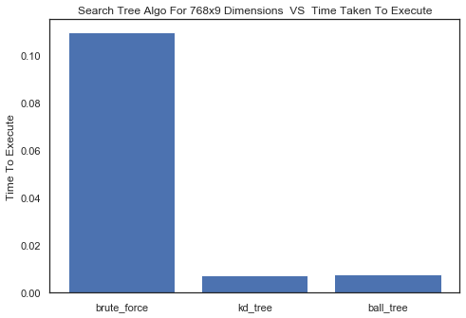
Project Work
LOW DIMENSION
Diabetes Data : N=768
D=9
-Brute Force Search does not work Well
-Ball-Tree Works Better Than Brute Force Search
-K-d Tree also Works better
Python Time plot

Slide 16
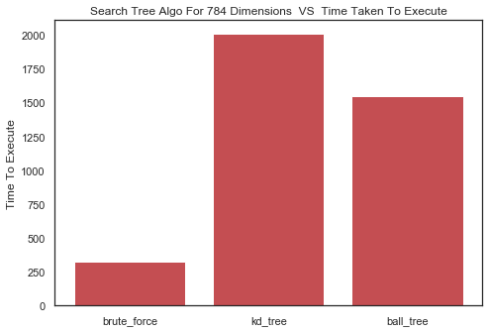
Project Work
HIGH DIMENSION
MNIST Data :
N=60,000
D=784
-Brute Force Search does
Much Better Than Others
33.46 Mins
25.76 Mins
5.35 Mins
Python Time plot

Slide 17
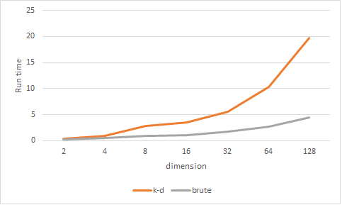
Some More Insight
Reason ?
https://stackoverflow.com/questions/50551877/comparison-search-time-between-k-d-tree-and-brute-force

Slide 18
Underline Factors
Data structure: intrinsic dimensionality of the data or sparsity of the data. Intrinsic dimensionality refers to the dimension d≤D of a manifold on which the data lies, which can be linearly or non-linearly embedded in the parameter space. Sparsity refers to the degree to which the data fills the parameter space (this is to be distinguished from the concept as used in “sparse” matrices. The data matrix may have no zero entries, but the structure can still be “sparse” in this sense).
Brute force query time is unchanged by data structure.
Ball tree and KD tree query times can be greatly influenced by data structure. In general, sparser data with a smaller intrinsic dimensionality leads to faster query times.

Slide 19
Number of neighbours k requested for a query point:
Brute force query time is largely unaffected by the value of k
Ball tree and k-d tree query time will become slower as k increases. This is due to two effects: first, a larger k leads to the necessity to search a larger portion of the parameter space. Second, using k>1 requires internal queueing of results as the tree is traversed.
Effect Of Leaf Size :
Construction time
- A large Leaf Size leads to a faster tree construction time, because fewer nodes need to be created
Query time
- Leaf Size approaching 1, the overhead involved in traversing nodes can significantly slow query times.
- Leaf Size approaching the size of the training set, queries become essentially brute force.

Slide 20
Sklearn.n_jobs=-1 vs n_jobs=1
- with n_jobs=1 it uses 100% of the CPU of one of the cores. Each process is run in a different core.
- In Linux with 4 cores the CPU usage:(100%,~5%, ~5%, ~5%) when
n_jobs=1 and (100%, 100%, 100%, 100%) when running with n_jobs=-1.
Parallel Computing Comes To Rescue
Brute Force : Calculates Almost All Vector Distances in Single Iteration.
In Binary Search Tree Like BALL-TREE, k-d TREE which works on Space
Partitioning & Searching Can’t Partition in low number of Iterations.
This soul Reason Takes Longer Time .

Slide 21
Model Optimization
KNN
97%
MLP
98%
CNN
98.4%
MNIST DATA

Slide 22
Scope Of Study
In machine learning problems that involve learning a "state-of-nature" from a finite number of data samples in a high-dimensional feature space with each feature having a range of possible values, typically an enormous amount of training data is required to ensure that there are several samples with each combination of values. A typical “rule of thumb is that there should be at least 5 training examples for each dimension in the representation”. With a fixed number of training samples, the predictive power of a classifier or regressor first increases as number of dimensions or features used is increased but then decreases, which is known as Hughes phenomenon[ or peaking phenomena.

Slide 23


